Slide 1
Mechanical Properties of Metallic Components Additively Manufactured by Directed Energy Deposition Laser with Powder as Feedstock Material
Master thesis Project
Calil Amaral
Orientador: Milton Pereira
Co-orientador: Walter Lindolfo Weingaertner
08/11/2019

Slide 2
AGENDA
Calil Amaral, 08/11/2019
INTRODUCTION
Objectives
LITERATURE REVIEW
Additive Manufacturing
Directed Energy Deposition (DED)
Laser Technology
Directed Energy Deposition Laser with Powder (DED-LP)
MATERIALS AND METHODS
Methodology
Technical and Financial Resources
SCHEDULE
REFERENCES

Slide 3
INTRODUCTION
Calil Amaral, 08/11/2019
Additive manufacturing, mechanical design and mechanical properties of metallic materials

Slide 4
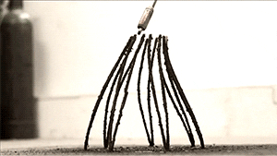
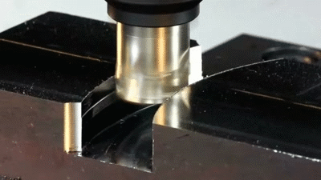
INTRODUCTION
Calil Amaral, 08/11/2019
What is additive manufacturing?
Additive Manufacturing (AM): “process of joining materials to make parts from 3D model data, usually layer upon layer, as opposed to subtractive manufacturing and formative manufacturing”
(ISO/ASTM 52900:2015(E))
Additive Manufacturing
Subtractive Manufacturing
Source: http://www.reddit.com/r/gifs/comments/221wog/large_scale_multi_axis_3d_printing_in_metal/
Source: https://plus.google.com/communities/113275241163938593797/stream/3bea93dc-f151-4ade-bab0-11ab6d7c4577
Notes:
What is Additive Manufacturing?

Slide 5
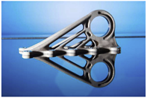
INTRODUCTION
Calil Amaral, 08/11/2019
(VOLPATO et al., 2017)
Main process advantages
Compared to process with dependence on tooling
Moulds
Reduced total cost for small batches
Dies
(VOLPATO et al., 2017)
(ZHANG; LIU; TO, 2017)
Model -> Data -> Production
Part count reduction
Digital process
Design optimization
Additive Manufacturing
Reduced supply chain
Reduced time between ideation and production
Design freedom

Slide 6
INTRODUCTION
Calil Amaral, 08/11/2019
(BOURELL; LEU; ROSEN, 2009)
Main process challenges
Production cost will drop
Few technologies available
Still expensive for metals
PBF
(BOURELL; LEU; ROSEN, 2009)
DED
Component properties
Geometry restrictions
Additive Manufacturing
(BOURELL; LEU; ROSEN, 2009)
Lack of diffuse knowledge
Design shift
Process dependent attributes
Complex design paradigm

Slide 7
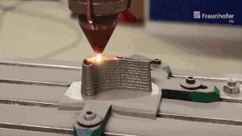
INTRODUCTION
Calil Amaral, 08/11/2019
Process analysis
Model - Boundary conditions - Solution
Geometry
Processing parameters
Distortion
Material
Mechanical properties
?
Input
Results
(Fraunhofer IPK, 2019)
https://www.linkedin.com/posts/max-biegler-051152123_additivemanufacturing-ded-industrialam-activity-6597026784695341056-nj2I

Slide 8
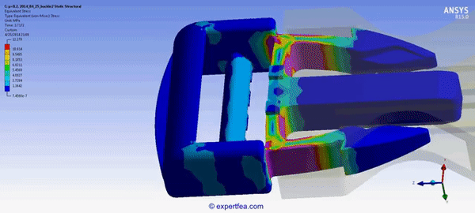
INTRODUCTION
Calil Amaral, 08/11/2019
Structural analysis
Model - Boundary conditions - Solution
Stress
Mechanical properties
Strain
Geometry
Deformation
Input
Results
Source:
https://gfycat.com/plainanguishedhyracotherium

Slide 9
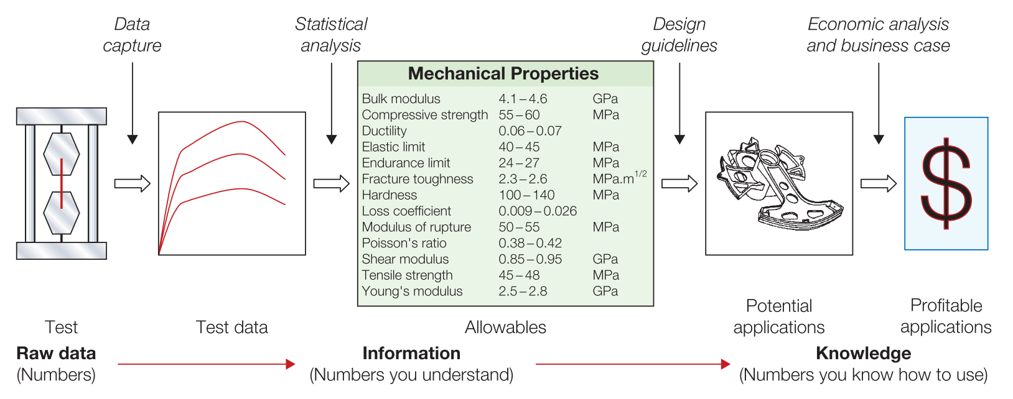
INTRODUCTION
Calil Amaral, 08/11/2019
Structural properties and design phase
(ASHBY, 2011)

Slide 10
INTRODUCTION
Calil Amaral, 08/11/2019
General objective
Propose a method to map the effects of key geometrical and processing parameters on the mechanical properties of samples produced by DED-LP.

Slide 11
INTRODUCTION
Calil Amaral, 08/11/2019
Specific objectives
1. Select from the literature, critical geometric features that can induce variation in mechanical properties (e.g. aspect ratio, wall thickness, curvature radius and part height)
2. Select from the literature, critical processing parameters (e.g. processing speed, laser power, processing strategies and overlap distance) that can induce mechanical property variation;
3. Define processing parameter levels that result in a stable process for manufacturing the selected geometric features;
4. Successfully manufacture geometries with selected features and machine local samples for uniaxial tensile tests;

Slide 12
INTRODUCTION
Calil Amaral, 08/11/2019
Specific objectives
5. Conduct mechanical tests to characterize:
a. Elastic modulus (E);
b. Elastic limit (Se);
c. Tensile strength (Su);
d. Elongation at fracture (ε);
6. Report the dependency of the measured values on the build direction and other geometric and process parameters;
7. Compare properties with those manufactured by a conventional process;

Slide 13
AGENDA
Calil Amaral, 08/11/2019
INTRODUCTION
Objectives
LITERATURE REVIEW
Additive Manufacturing
Directed Energy Deposition (DED)
Directed Energy Deposition Laser with Powder (DED-LP)
Laser Technology
MATERIALS AND METHODS
Methodology
Technical and Financial Resources
SCHEDULE
REFERENCES

Slide 14
LITERATURE REVIEW
Calil Amaral, 08/11/2019
Directed Energy Deposition, laser technology, process description and resulting properties

Slide 15
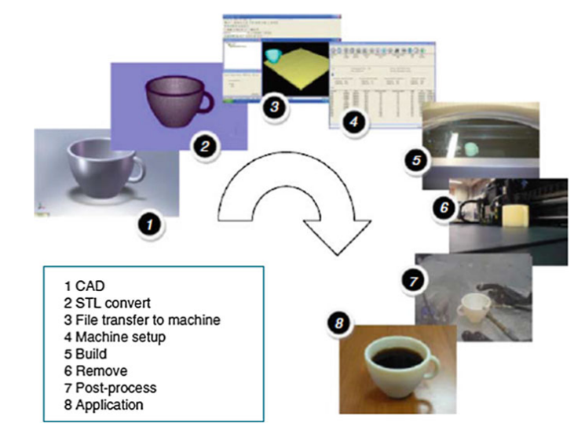
LITERATURE REVIEW
Calil Amaral, 08/11/2019
Additive Manufacturing
(GIBSON; ROSEN; STUCKER, 2015)

Slide 16



LITERATURE REVIEW
Calil Amaral, 08/11/2019
Additive Manufacturing
1892
1972
1998
2009
Blanther
Matsubara
Sandia
ASTM F42
Moldes para mapas topográficos
Mitsubishi Motors; Cura seletiva de resinas fotopolimerizáveis
LENS - Laser Engineered Net Shaping
Formação do comitê para manufatura aditiva
(Bae et. Al, 2018)
(Volpato et. Al, 2017)

Slide 17
LITERATURE REVIEW
Calil Amaral, 08/11/2019
Additive Manufacturing
01
VAT Photopolymerization
02
Powder Bed Fusion
“DED is an additive manufacturing process in which focused thermal energy is used to fuse materials by melting as they are being deposited.”
03
Binder Jetting
04
2015
Directed Energy Deposition
05
Sheet Lamination
(ISO/ASTM 52900-15)
06
Material Jetting
07
Material Extrusion

Slide 18
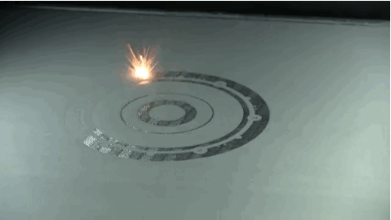
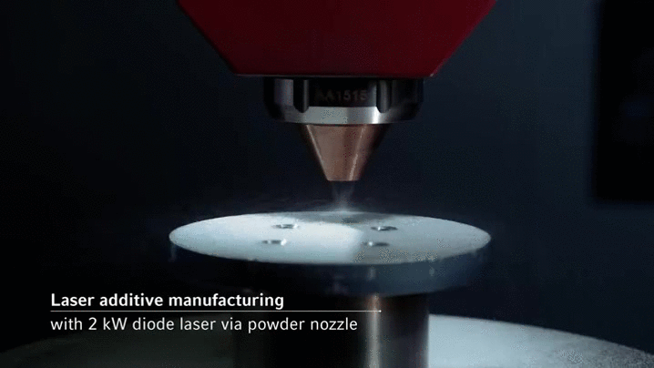
INTRODUCTION
Calil Amaral, 08/11/2019
Additive Manufacturing - DED and PBF technologies
Powder Bed Fusion (PBF)
Directed Energy Deposition (DED-LP)
Source: https://giphy.com/gifs/ge-3d-printing-aviation-jet-engine-5xA4HomdGgi2Y
Source: http://imgur.com/gallery/QkZgH

Slide 19
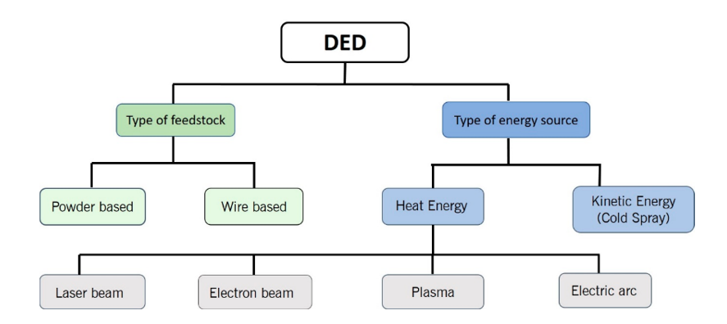
LITERATURE REVIEW
Calil Amaral, 08/11/2019
Additive Manufacturing - Directed Energy Deposition Laser with Powder as feedstock (DED-LP)
(DED-LP)
(DASS; MORIDI, 2019)

Slide 20
LITERATURE REVIEW
Calil Amaral, 08/11/2019
Laser Technology - What is Laser and when it was created?
LASER
Light Amplification Stimulated by Emission of Radiation
First activity reported in 1960 by Theodore Harold Maiman
Wavelength (λ)
“A special type of light”
Intensity (I)
(HITZ; EWING; HECHT, 2012)

Slide 21
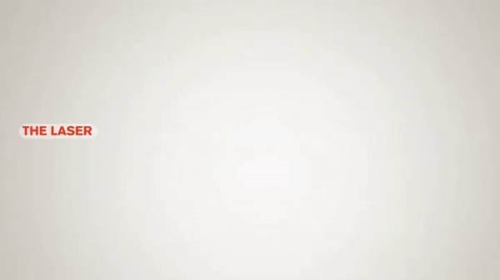
LITERATURE REVIEW
Calil Amaral, 08/11/2019
Laser Technology - Como funciona o LASER?
https://giphy.com/gifs/how-laser-works-dYlZEmJoVRl28

Slide 22
LITERATURE REVIEW
Calil Amaral, 08/11/2019
Laser Technology - Important landmarks
44 anos
43 anos
1873
1917
1960
...
...
Maxwell
Einstein
Theodore Harold Maiman
description of electromagnetic radiation
spontaneous emission and absorption
stimulated emission
pulsed laser activity of a ruby laser
(POPRAWE; BOUCKE; HOFFMAN, 2018)

Slide 23
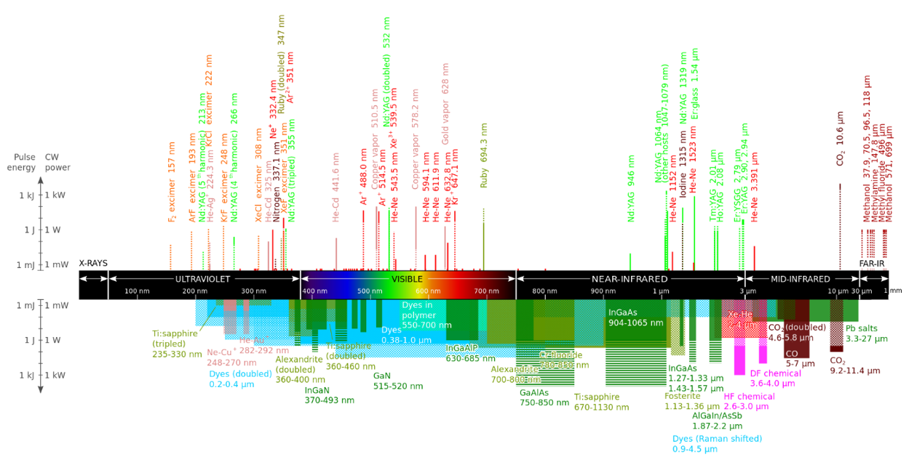
LITERATURE REVIEW
Calil Amaral, 08/11/2019
LMP
I ≤ 10 kW
λ = 1070 a 1080nm
Laser Technology - Commercially available lasers (λ, I)
(DANH, 2009)

Slide 24
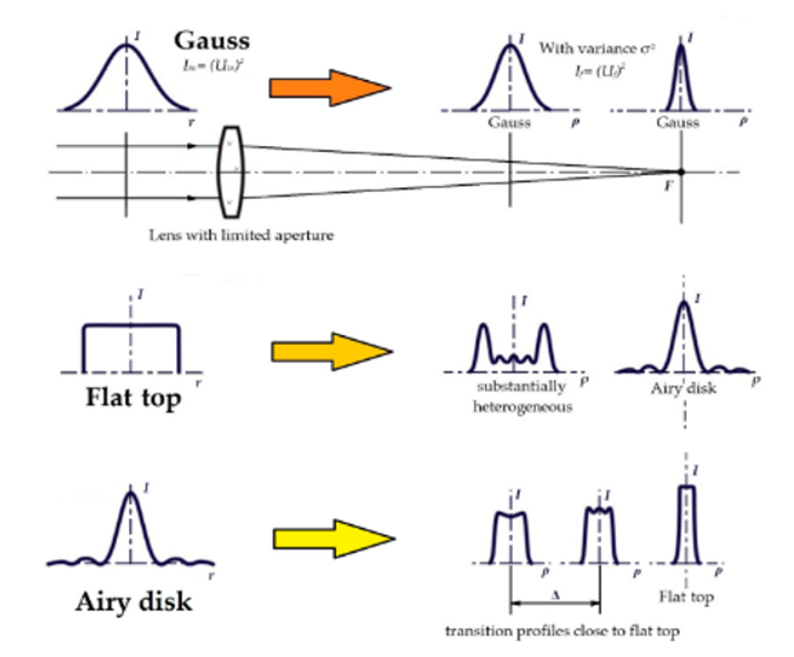
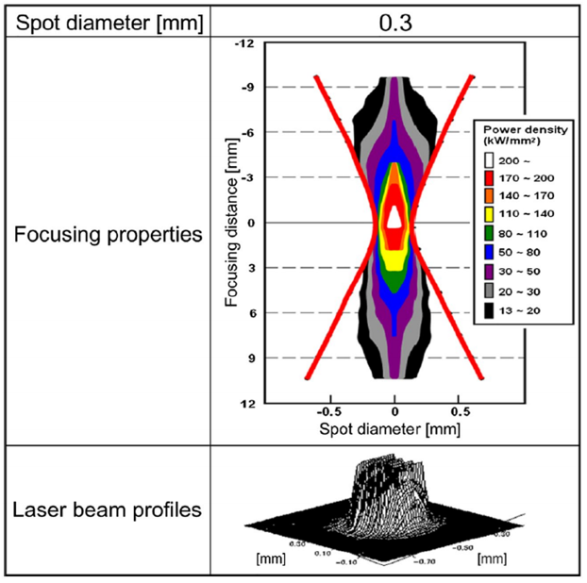
LITERATURE REVIEW
Calil Amaral, 08/11/2019
Laser Technology - Optics and energy distribution
(KAWAHITO et al., 2016)

Slide 25
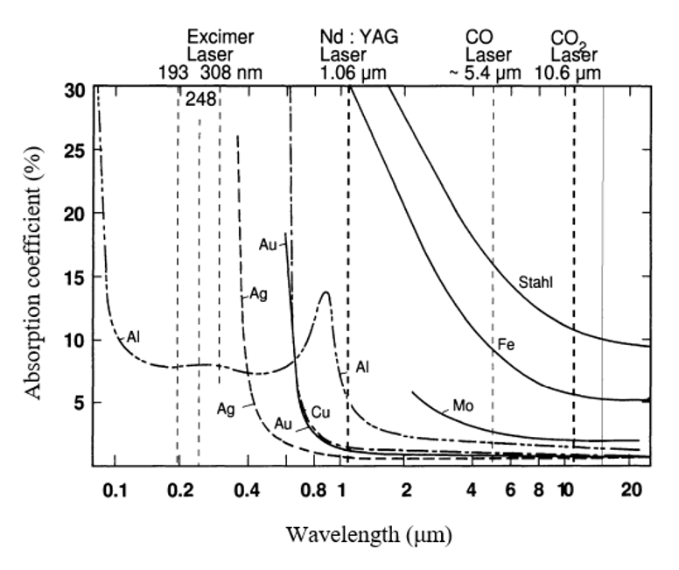
LITERATURE REVIEW
Calil Amaral, 08/11/2019
Laser Technology - Material processing and energy conversion
“... fundamental principles involved in laser material processing is related to absorption of light by the workpiece and its partial conversion to heat.”
Absorption depends on
Wavelength
Polarization
Material physical properties
Workpiece surface
(POPRAWE, 2016)
(HERZIGER; WEBER, 1998)

Slide 26
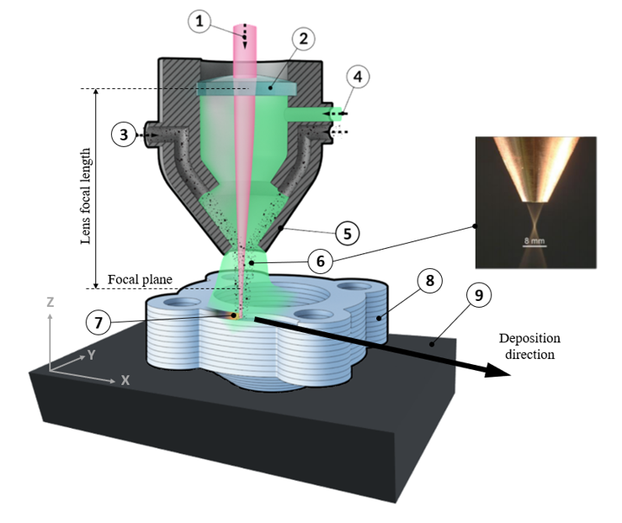
LITERATURE REVIEW
Calil Amaral, 08/11/2019
DED-LP: Process description
Source: http://imgur.com/gallery/QkZgH
Adapted from (MANUFACTURING GUIDE) and (POPRAWE, 2016)

Slide 27
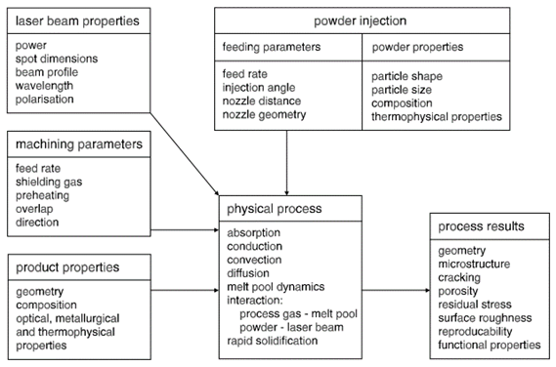
LITERATURE REVIEW
Calil Amaral, 08/11/2019
DED-LP: Process description
Objetivo
(SCHNEIDER, 1998)

Slide 28
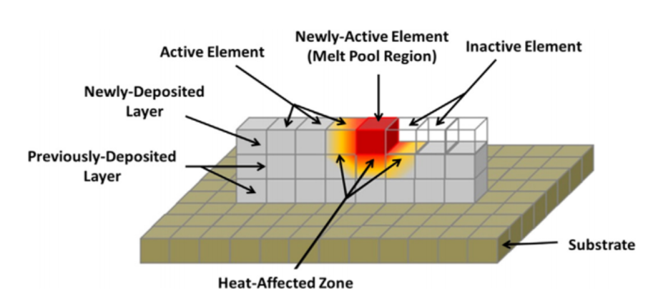
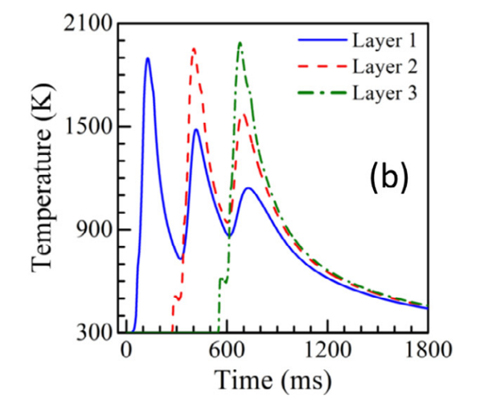
LITERATURE REVIEW
Calil Amaral, 08/11/2019
Thermal cycles, microstructure refinement and heterogeneity
Absorption
Melting
Solidifying
Re-heating
Recooling
Thermal Cycle
(THOMPSON, 2015)
(MANVATKAR; DE; DEBROY, 2014)
Voxel
Maxel

Slide 29
LITERATURE REVIEW
Calil Amaral, 08/11/2019
Thermal cycles, microstructure refinement and heterogeneity
“Independently of the material, a fine-grained structure has usually been observed for AM in comparison to other processes (e.g. casting)”
(HERZOG et al., 2016)
“The effect can be explained by the high cooling rates of up to 12000 K/s when compared with 1 – 100 K/s for casting”
(DEBROY et al., 2017)

Slide 30
LITERATURE REVIEW
Calil Amaral, 08/11/2019
DED-LP: Thermal cycles, cooling rates and local heat input
“The effect can be explained by the high cooling rates of up to 12000 K/s when compared with 1 – 100 K/s for casting”
(DEBROY et al., 2017)
“a result of the very local heat input and the small volumes of molten material”
(HERZOG et al., 2016)

Slide 31
LITERATURE REVIEW
Calil Amaral, 08/11/2019
Thermal cycles, microstructure refinement and heterogeneity
“Temperature gradients are also affected by the property gradients along the voxels of the structure. The presence of solidified materials on previous layers typically increase the heat conduction in the build direction compared with other special directions, what can explain the observed anisotropy in microstructure and mechanical properties”
(HERZOG et al., 2016)

Slide 32
LITERATURE REVIEW
Calil Amaral, 08/11/2019
Porosity and mechanical properties
“As porosity facilitates crack propagation and deteriorates mechanical properties, the manufacture of parts with a high density, typically greater than 99.5%, is the first goal in AM process optimization”
(HERZOG et al., 2016)

Slide 33
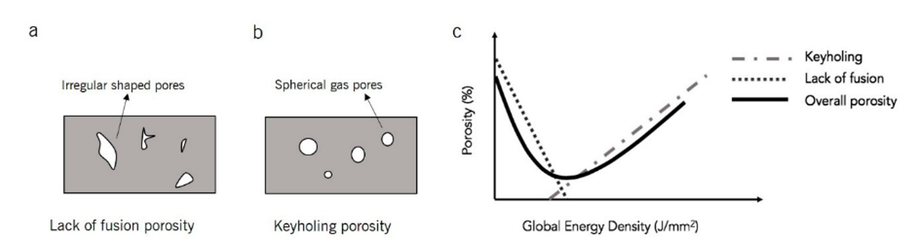
LITERATURE REVIEW
Calil Amaral, 08/11/2019
Processing parameters and porosity
Low energy density
High energy density
(DASS; MORIDI, 2019)

Slide 34
LITERATURE REVIEW
Calil Amaral, 08/11/2019
Processing parameters and porosity
“The static strength of Ti-6Al-4V and Inconel 625 do not vary significantly between AM porous and non-porous specimens compared with wrought specimens”
(RAZAVI et al., 2018a)(KOIKE et al., 2017)

Slide 35
LITERATURE REVIEW
Calil Amaral, 08/11/2019
Processing parameters and porosity
On the other hand, the presence of stress raisers reduce the ductility of materials significantly and for this reason, fatigue strength of porous specimens reduce significantly as the presence of stress raisers facilitates fatigue crack initiation and fatigue crack propagation along the sample
(RAZAVI et al., 2018b)

Slide 36
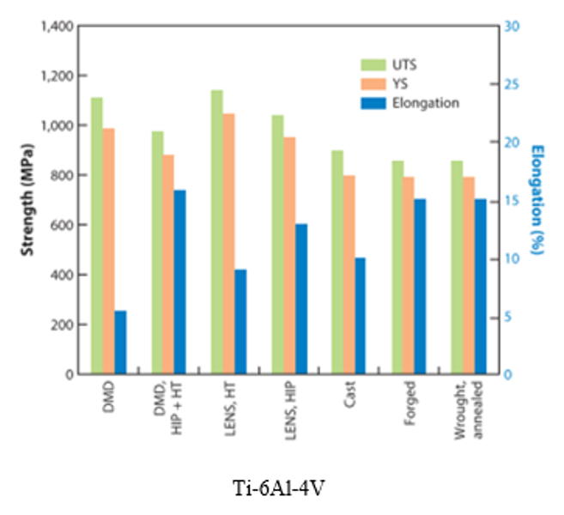
LITERATURE REVIEW
Calil Amaral, 08/11/2019
Reported mechanical properties
(LEWANDOWSKI; SEIFI, 2016)

Slide 37
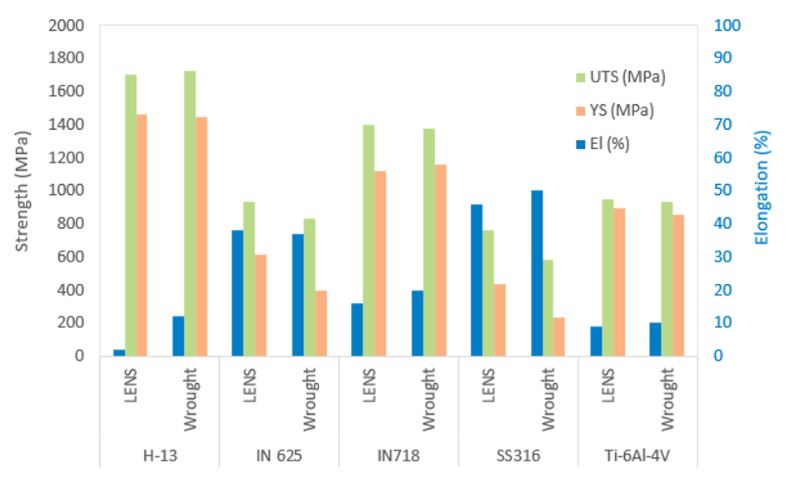
LITERATURE REVIEW
Calil Amaral, 08/11/2019
Reported mechanical properties
Adapted from (GRIFFITH et al., 2000)

Slide 38
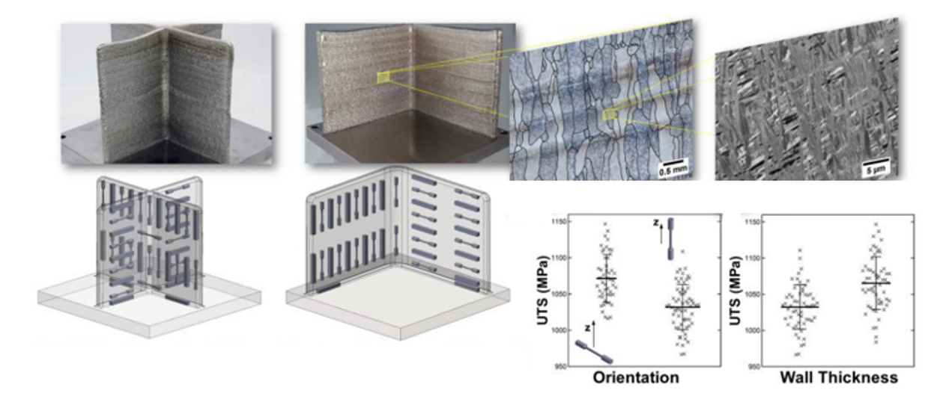
LITERATURE REVIEW
Calil Amaral, 08/11/2019
Geometry and Mechanical Properties
Ti-6Al-4V
(KEIST; PALMER, 2016)

Slide 39
AGENDA
Calil Amaral, 08/11/2019
INTRODUCTION
Objectives
LITERATURE REVIEW
Additive Manufacturing
Directed Energy Deposition (DED)
Directed Energy Deposition Laser with Powder (DED-LP)
Laser Technology
MATERIALS AND METHODS
Methodology
Technical and Financial Resources
SCHEDULE
REFERENCES

Slide 40
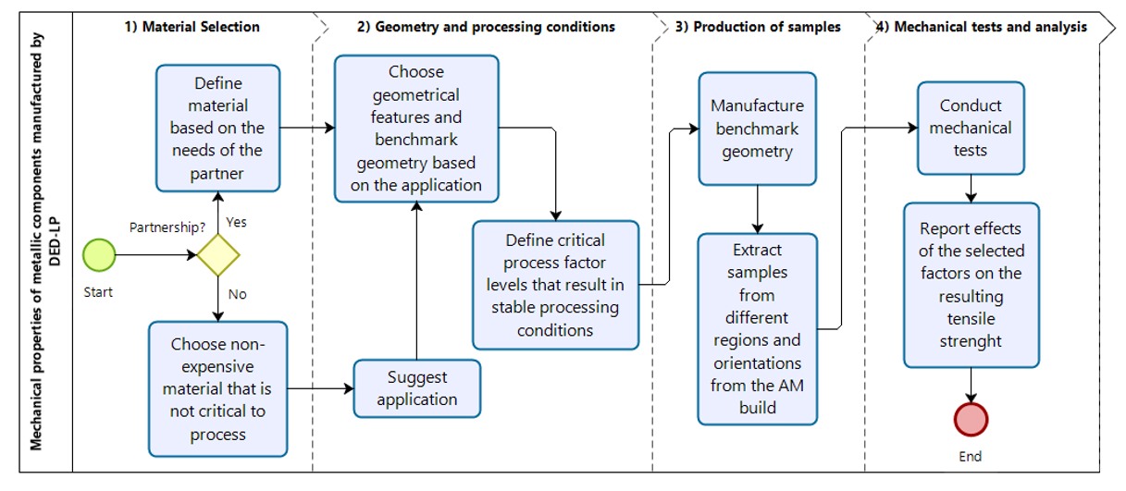
MATERIALS AND METHODS
Calil Amaral, 08/11/2019
Summary of project phases
Preliminary tests:
High density
Stable process

Slide 41
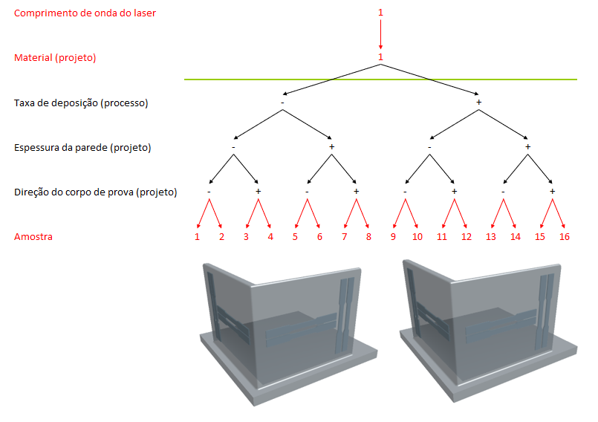
MATERIALS AND METHODS
Calil Amaral, 08/11/2019
Summary of project phases
Mínimo
Limite de ensaios: 32
LabMat

Slide 42
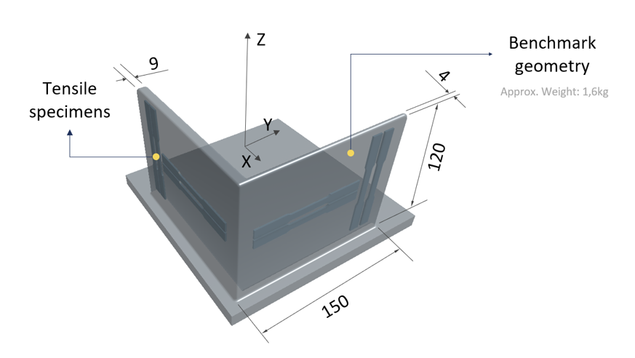
MATERIALS AND METHODS
Calil Amaral, 08/11/2019
Benchmark Geometry
Tensile

Slide 43




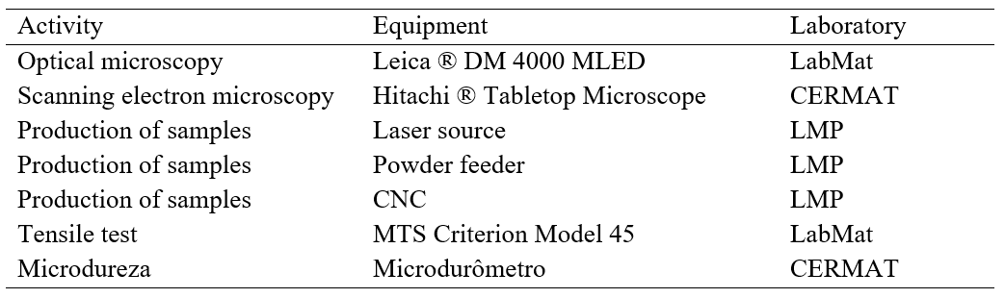
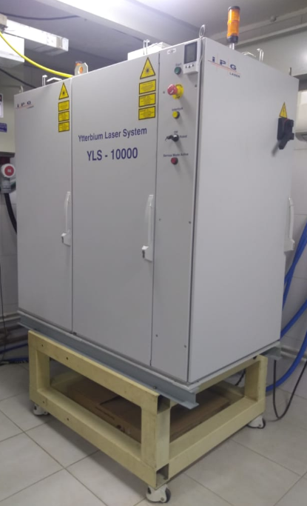
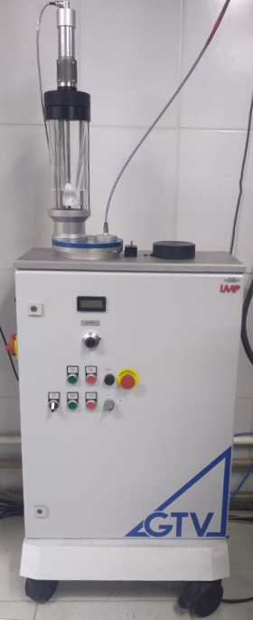
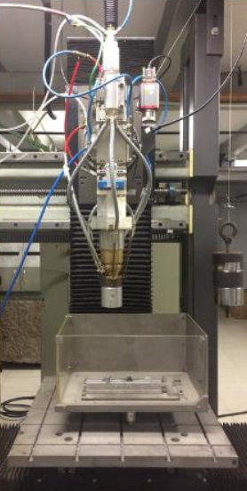
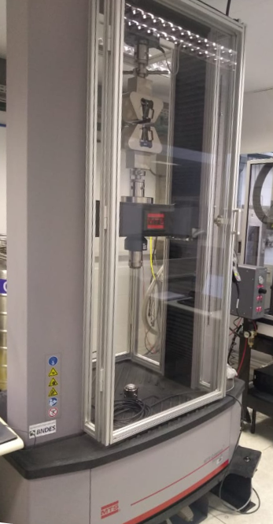
MATERIALS AND METHODS
Calil Amaral, 08/11/2019
Resources - Equipments

Slide 44
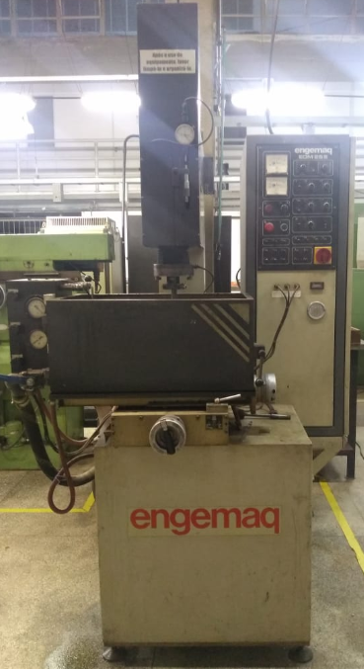
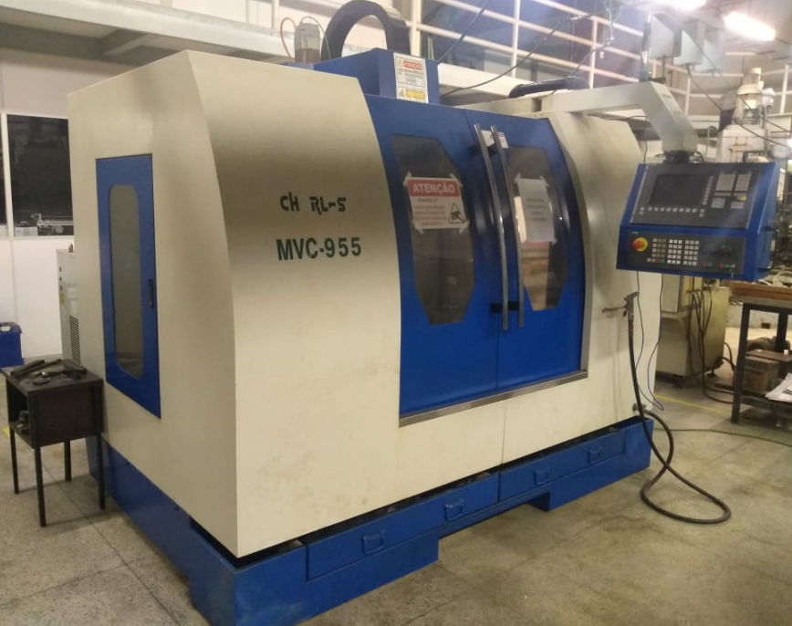
MATERIALS AND METHODS
Calil Amaral, 08/11/2019
Resources - Machining of tensile samples
CNC - Charles MVC955
Electrical Discharge Machining

Slide 45
AGENDA
Calil Amaral, 08/11/2019
INTRODUCTION
Objectives
LITERATURE REVIEW
Additive Manufacturing
Directed Energy Deposition (DED)
Directed Energy Deposition Laser with Powder (DED-LP)
Laser Technology
MATERIALS AND METHODS
Methodology
Technical and Financial Resources
SCHEDULE
REFERENCES

Slide 46
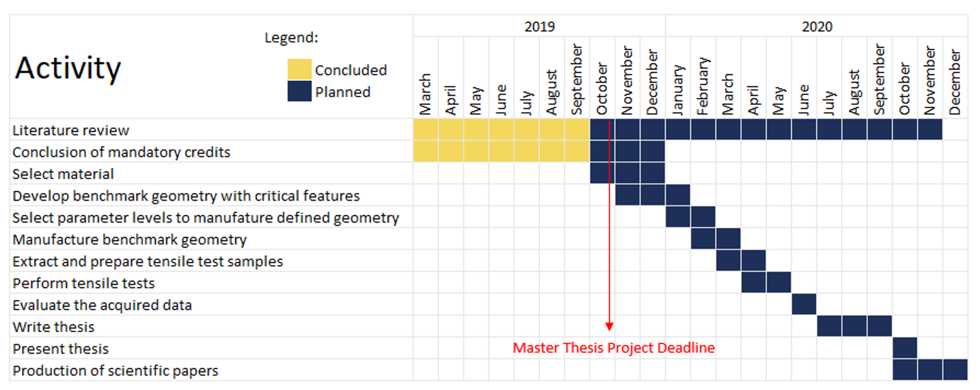
SCHEDULE
Calil Amaral, 08/11/2019
Detailed activities

Slide 47
AGENDA
Calil Amaral, 08/11/2019
INTRODUCTION
Objectives
LITERATURE REVIEW
Additive Manufacturing
Directed Energy Deposition (DED)
Directed Energy Deposition Laser with Powder (DED-LP)
Laser Technology
MATERIALS AND METHODS
Methodology
Technical and Financial Resources
SCHEDULE
REFERENCES

Slide 48
REFERENCES
Calil Amaral, 08/11/2019
ANSARI, M. et al. Laser directed energy deposition of water-atomized iron powder: Process optimization and microstructure of single-tracks. Optics & Laser Technology, v. 112, p. 485–493, 2019.
ASHBY, M. Materials selection in mechanical design: Fourth edition. 4th. ed. Burlington: Elsevier, 2011.
ASTM INT. Standard Test Methods for Tension Testing of Metallic Materials 1 - ASTM E8M-13a. Astm, n. C, p. 1–28, 2014.
ASTM; ISO. F3187 − 16: Standard Guide for Directed Energy Deposition of Metals 1. p. 1–22, 2019.
BAE, C.-J.; DIGGS, A. B.; RAMACHANDRAN, A. Quantification and certification of additive manufacturing materials and processes. In: Additive Manufacturing : Materials, Processes, Quantifications and Applications. Cambridge, MA: Butterworth-Heinemann, 2018. p. 181–213.
BOURELL, D. L.; LEU, M. C. .; ROSEN, D. W. Roadmap for Additive Manufacturing: Identifying the Future of Freeform ProcessingThe University of Texas at Austin. Austin, TX: [s.n.].
BOURELL, D. L.; ROSEN, D. W.; LEU, M. C. The roadmap for additive manufacturing and its impact. 3D Printing and Additive Manufacturing, v. 1, n. 1, p. 6–9, 2014.
CAFFREY, T.; WOHLERS, T. Additive manufacturing state of the industry. Manufacturing Engineering, 2015.
DANH. Commercial Laser Lines. Disponível em: <https://en.wikipedia.org/wiki/List_of_laser_types#/media/File:Commercial_laser_lines.svg>. Acesso em: 15 out. 2019.
DASS, A.; MORIDI, A. State of the Art in Directed Energy Deposition: From Additive Manufacturing to Materials Design. Coatings, 2019.
DEBROY, T. et al. Additive manufacturing of metallic components – Process, structure and properties. Progress in Materials Science, v. 92, p. 112–224, 2017.
FRAZIER, W. E. Metal additive manufacturing: A review. Journal of Materials Engineering and Performance, 2014.
GIBSON, I.; ROSEN, D.; STUCKER, B. Additive manufacturing technologies: 3D printing, rapid prototyping, and direct digital manufacturing, second edition. 2nd. ed. New York, NY: Springer US, 2015.
GRIFFITH, M. L. et al. Understanding the Microstructure and Properties of Components Fabricated By Laser Engineered Net Shapgin (LENS). v. 625, p. 9–20, 2000.

Slide 49
REFERENCES
Calil Amaral, 08/11/2019
HANDBOOK, A. ASM Metals HandBook Volume 1 - Properties and Selections - Irons Steels and High and Performance. Technology, v. 2, p. 3470, 1990.
HERZIGER, G.; WEBER, H. Laser in Technik und Forschung. Berlin: Springer Berlin, 1998.
HERZOG, D. et al. Additive manufacturing of metals. Acta Materialia, v. 117, p. 371–392, 2016.
HITZ, C. B.; EWING, J.; HECHT, J. Introduction to Laser Technology. 4th. ed. New Jersey, NY: IEEE Press, 2012.
ISO; ASTM. ISO/ASTM 52900:2015(E) - Standard Terminology for Additive Manufacturing – General Principles – Terminology. v. i, p. 1–9, 2019.
KAWAHITO, Y. et al. Elucidation of the effect of welding speed on melt flows in high-brightness and high-power laser welding of stainless steel on basis of three-dimensional X-ray transmission in situ observation. Welding International, v. 31, n. 3, p. 206–213, 2016.
KEIST, J. S.; PALMER, T. A. Role of geometry on properties of additively manufactured Ti-6Al-4V structures fabricated using laser based directed energy deposition. Materials and Design, v. 106, p. 482–494, 2016.
KOIKE, R. et al. Study on correlation internal void and strength in direct energy deposition. p. 1033–1034, 2017.
KOK, Y. et al. Anisotropy and heterogeneity of microstructure and mechanical properties in metal additive manufacturing: A critical review. Materials & Design, 2017.
LEWANDOWSKI, J. J.; SEIFI, M. Metal Additive Manufacturing: A Review of Mechanical Properties. v. 46, n. 1, p. 151–186, 2016.
LIU, R. et al. Aerospace applications of laser additive manufacturing. In: Laser Additive Manufacturing: Materials, Design, Technologies, and Applications. [s.l.] Woodhead Publishing, 2017. p. 351–371.
MANUFACTURING GUIDE. Laser Cladding 3D, LC3D | Find suppliers, processes &amp; material. Disponível em: <https://www.manufacturingguide.com/en/laser-engineered-net-shaping-lens-0>. Acesso em: 4 jul. 2019.
MANVATKAR, V. D. et al. Estimation of melt pool dimensions, thermal cycle, and hardness distribution in the laser-engineered net shaping process of austenitic stainless steel. Metallurgical and Materials Transactions A: Physical Metallurgy and Materials Science, v. 42, n. 13, p. 4080–4087, 2011.
MANVATKAR, V.; DE, A.; DEBROY, T. Heat transfer and material flow during laser assisted multi-layer additive manufacturing. Journal of Applied Physics, v. 116, n. 12, 2014.
POPRAWE, R. Tailored Light 2 Laser Application Technology. Aachen, Germany: Springer, 2016.
POPRAWE, R.; BOUCKE, K.; HOFFMAN, D. Tailored Light 1 - High Power Lasers for Production. Aachen, Germany: Springer, 2018.

Slide 50
REFERENCES
Calil Amaral, 08/11/2019
RAZAVI, S. M. J. et al. Porosity effect on tensile behavior of Ti-6Al-4V specimens produced by laser engineered net shaping technology. Proceedings of the Institution of Mechanical Engineers, Part C: Journal of Mechanical Engineering Science, v. 0, n. 1, p. 1–8, 2018a.
RAZAVI, S. M. J. et al. Fatigue behavior of porous Ti-6Al-4V made by laser-engineered net shaping. Materials, v. 11, n. 2, 2018b.
SABOORI, A. et al. Application of Directed Energy Deposition-Based Additive Manufacturing in Repair. Applied Sciences, v. 9, n. 16, p. 3316, 2019.
SCHNEIDER, M. Laser clading with powder effect of some machining parameters on clad properties. [s.l.] University of Twente, Enschede, The Netherlands, 1998.
SHAH, K. et al. Parametric study of development of Inconel-steel functionally graded materials by laser direct metal deposition. Materials and Design, v. 54, p. 531–538, 2014.
VOLPATO, N. et al. Manufatura Aditiva - Tecnologias e aplicações da impressão 3D. São Paulo, SP: Blucher, 2017.
XU, J. et al. A review of slicing methods for directed energy deposition based additive manufacturing. Rapid Prototyping Journal, v. 24, n. 6, p. 1012–1025, 2018.
ZHANG, P.; LIU, J.; TO, A. C. Role of anisotropic properties on topology optimization of additive manufactured load bearing structures. Scripta Materialia, 2017.

Slide 51



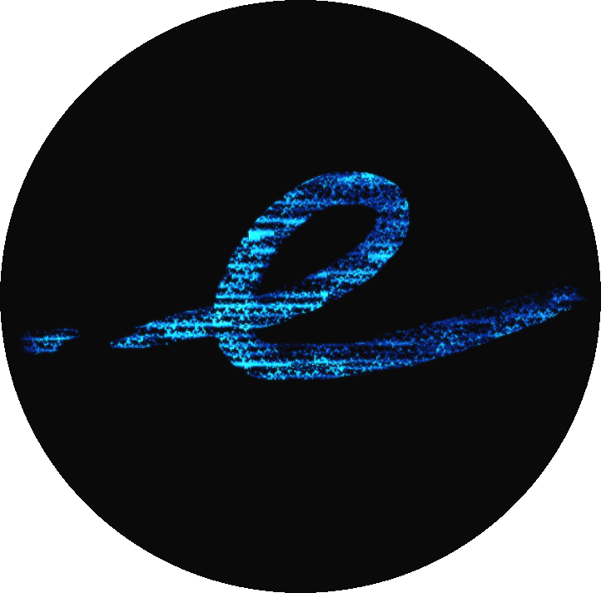
ACKNOWLEDGMENTS
Calil Amaral, 08/11/2019
Support

